Slide 1
Modern Terrain Rendering: Geometry Clipmaps and Concurrent Binary Trees
By Brighton Mica

Slide 2
Motivation
There is a demand for high fidelity, real-time terrain
Video Games
Global Information Systems (GIS)
Flight Simulators
Notes:
As scenes become more and more dense, we can spare less toward rendering processing

Slide 3
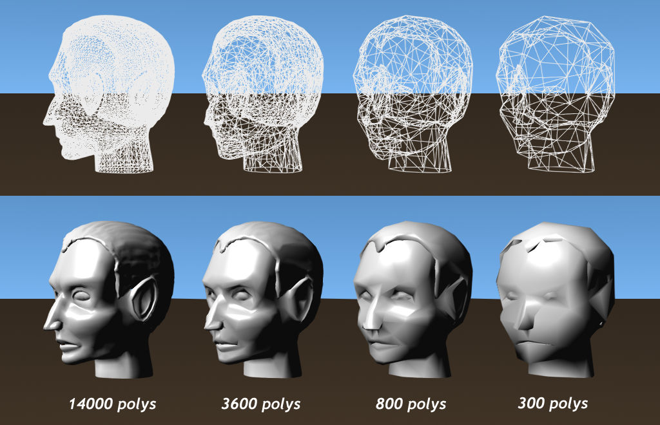
Motivation
There is a demand for high fidelity, real-time terrain
Video Games
Global Information Systems (GIS)
Flight Simulators
Discrete LOD
Notes:
As scenes become more and more dense, we can spare less toward rendering processing

Slide 4
Motivation
There is a demand for high fidelity, real-time terrain
Video Games
Global Information Systems (GIS)
Flight Simulators
Discrete LOD
What else is out there?
Notes:
As scenes become more and more dense, we can spare less toward rendering processing

Slide 5
Description of Work
Implemented
Tessellation Patches
Geometry Clipmaps
Comparison
Geometry Clipmaps vs Concurrent Binary Trees (CBTs) using Longest Edge Bisection (LEB)

Slide 6
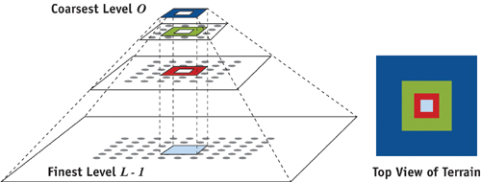
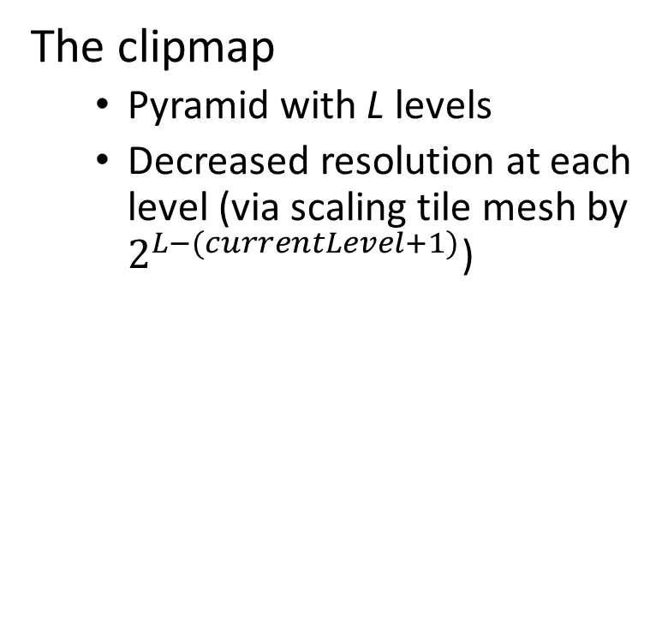
Geometry Clipmap
The clipmap
Pyramid with L levels
Decreased resolution at each level (via scaling tile mesh by $2^{L−(currentLevel+1)}$)

Slide 7
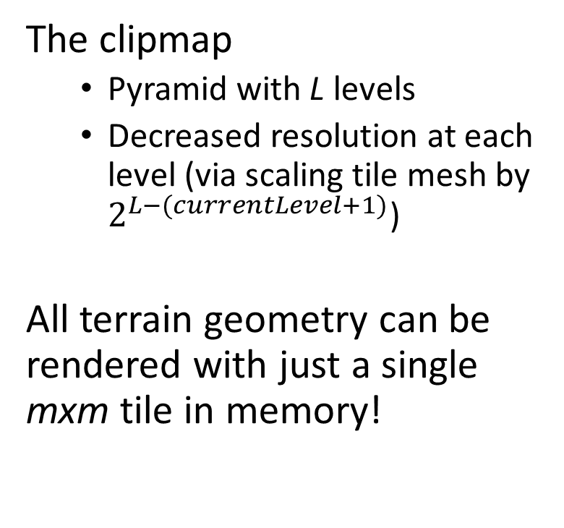
Geometry Clipmap
The clipmap
Pyramid with L levels
Decreased resolution at each level (via scaling tile mesh by $2^{L−(currentLevel+1)}$)
All terrain geometry can be rendered with just a single mxm tile in memory!

Slide 8
Morph Iteration
Single mxm tile mesh
Artifacts
Popping

Slide 9
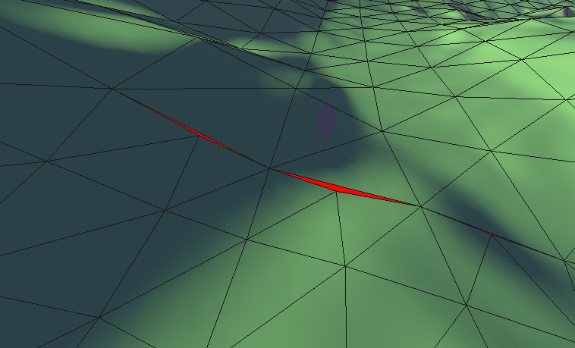
Morph Iteration
Single mxm tile mesh
Artifacts
Popping
Cracks

Slide 10
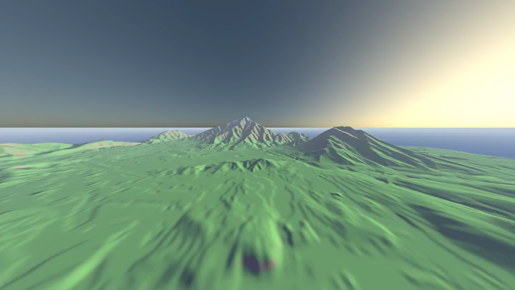
Morph Iteration
Single mxm tile mesh
Atrifacts
Popping
Cracks
Vertex Swimming

Slide 11
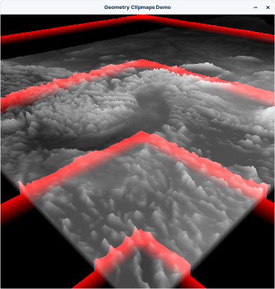
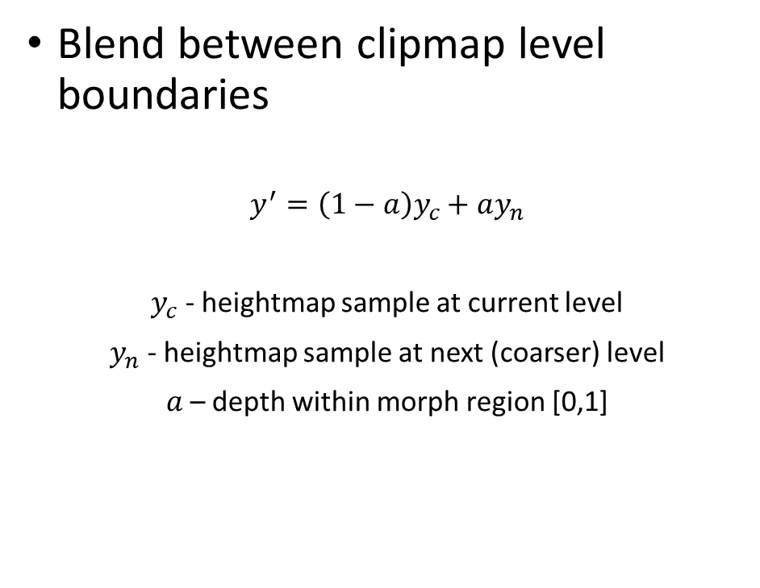
Morph Iteration
Blend between clipmap level boundaries
$$y^{′}=\left(1−a\right)y_{c}+ay_{n}$$
$y_{c}$ - heightmap sample at current level
$y_{n}$ - heightmap sample at next (coarser) level
$a$– depth within morph region [0,1]

Slide 12

Morph Iteration
Single mxm tile mesh
Artifacts
Popping
Cracks ???
Vertex Swimming ???

Slide 13
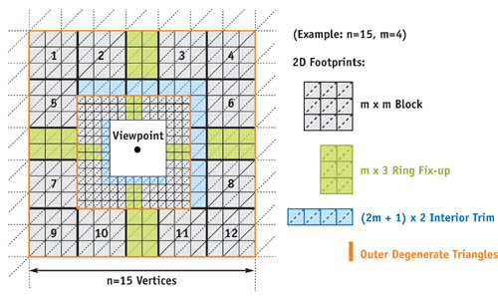
Mesh Iteration
Tile mesh (grey)
Trim mesh (blue)
Filler mesh (green)
Seam mesh (orange)

Slide 14




Trim Mesh

Slide 15
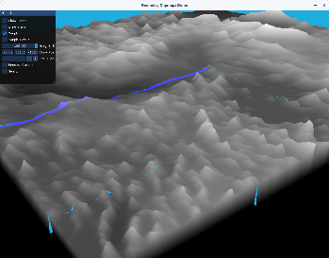
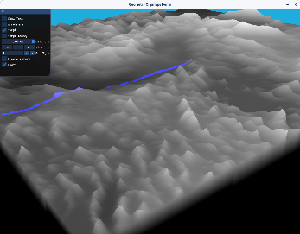
Seam Mesh
Without Seam Mesh
With Seam Mesh

Slide 16
Mesh Iteration
Artifacts
Popping
Cracks ???
Vertex Swimming

Slide 17
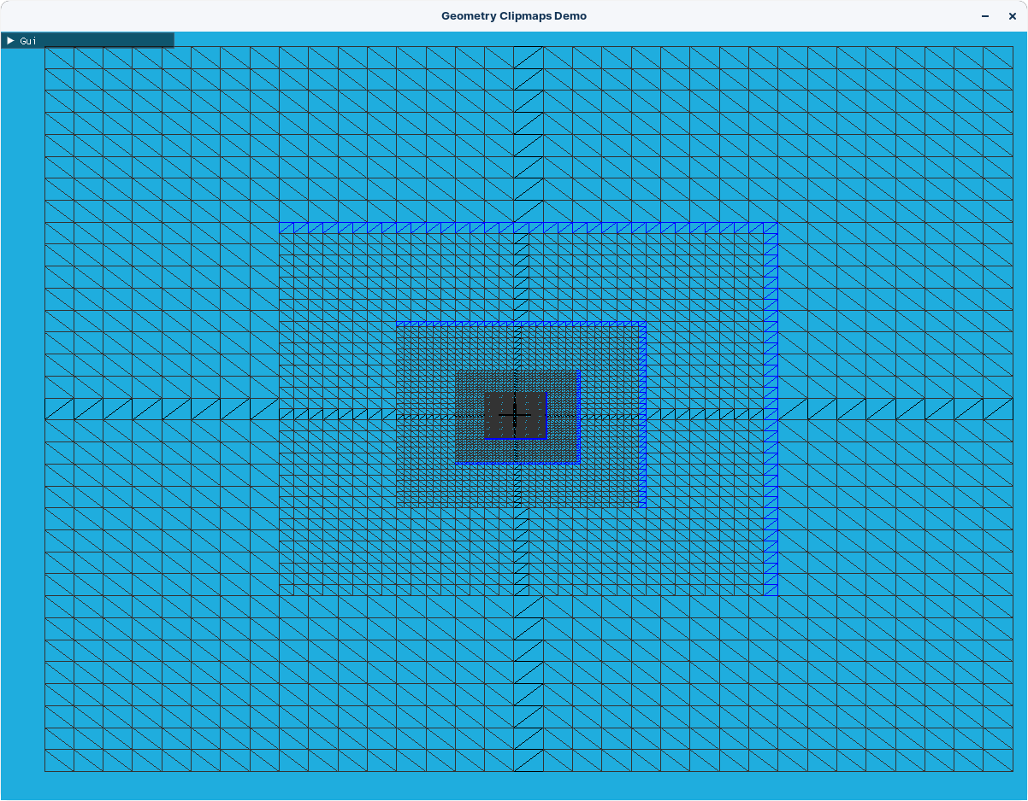
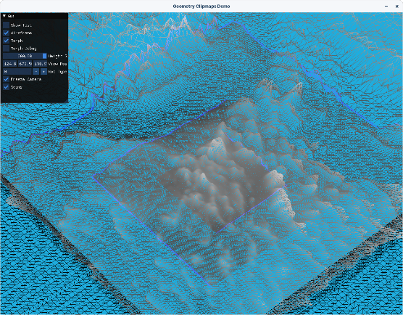

Slide 18
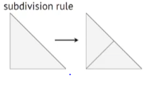
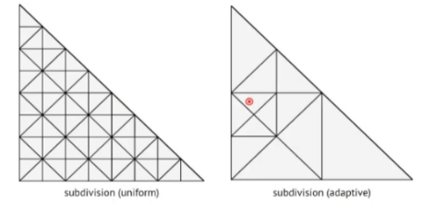
CBTs and LEB
Notes:
Goal was to compute this adaptive triangulation in parallel

Slide 19

LEB – Link With Binary Trees

Slide 20
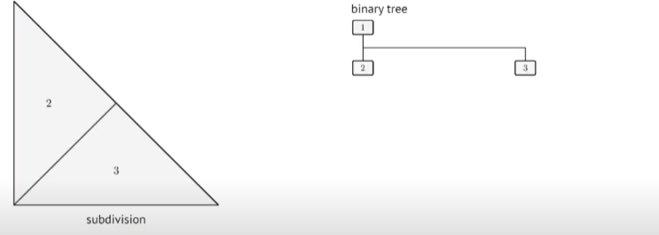
CBTs and LEB

Slide 21
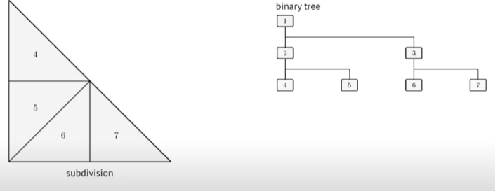
CBTs and LEB
Notes:
Leaf nodes represent actual geometry (true for adaptive or uniform subdivision
What’ useful about this is that the problem of dispatching a thread for each triangle can be reformulated into… what are the leaf noes a of a binary tree
In order to dothis in parallel the CBT was introduced.

Slide 22
Geometry Clipmaps: Performance Analysis
Table 1: Geometry Clipmaps
L | m | GPU(ms) | Triangle Count
4 | 128 | 7.75 | 786,432
5 | 64 | 3.25 | 245,740
6 | 32 | 2.01 | 73,728
7 | 16 | 1.76 | 21,504
Coarsest clipmap level would stretch far beyond scene boundaries

Slide 23
CBTs with LEB: Performance Analysis
Table 2: CBT with LEB
D | GPU (ms) | Triangle Count
27 | 1.70 | 1,484

Slide 24
Performance Analysis
Triangle Count Test (Clipmap)
Triangle Count | GPU(ms)
21,504 | 1.76
73,728 | 2.01
245,740 | 3.25
786,432 | 7.75
Triangle Count Test (CBT with LEB)
Triangle Count | GPU (ms)
4,389 | 2.7
16,218 | 3.03
59,119 | 4.32
119,739 | 8.62

Slide 25
Performance Analysis
So why do climaps require more time achieve the same level visual acuity of CBT with LEB when it can output more triangles per second?

Slide 26
Performance Analysis
So why do climaps require more time achieve the same level visual acuity of CBT with LEB when it can output more triangles per second?
Geometry clipmaps suffer a relatively poor, naive spatial partitioning. Clipmaps levels are rendered at the same resolution.

Slide 27
Performance Analysis
So why do climaps require more time achieve the same level visual acuity of CBT with LEB when it can output more triangles per second?
Geometry clipmaps suffer a relatively poor, naive spatial partitioning. Clipmaps levels are rendered at the same resolution.
CBT with LEB is more flexible and may only subdivide/render when needed.

Slide 28
Code
Clipmap: https://github.com/m-i-c-a/Terrain.git
Tesselation Patches: https://github.com/m-i-c-a/Tess-Terrain.git

Slide 29
References
Losasso, Frank, and Hugues Hoppe. 2004. "Geometry Clipmaps: Terrain Rendering Using Nested Regular Grids." ACM Transactions on Graphics (Proceedings of SIGGRAPH 2004) 23(3), pp. 769–776.
Arul Asirvatham, and Hugues Hoppe. 2005. “GPU gems 2 : programming techniques for high-performance graphics and general-purpose computation”, pp. 27-45
Morgan McGuire. 2014. “Fast Terrain Rendering with Continuous Detail on a Modern GPU”. Morgan McGuire on Graphics & Games. http://casual-effects.blogspot.com/2014/04/fast-terrain-rendering-with-continuous.html
Marcin Gollent. 2014. “Landscape creation and rendering in REDengine 3”. [Game Developers Conference]. San Francisco, CA. United States
Mike J. Savage. 2017. “Geometry clipmaps: simple terrain rendering with level of detail”. https://mikejsavage.co.uk/blog/geometry-clipmaps.html
DELIOT T., YAO X., DUPUY J., RIJNEN K.: Experimenting with Concurrent Binary Trees: Large Scale Terrain Rendering. In ACM SIGGRAPH 2021 Courses, Advances in Real-Time Rendering in Games (2021), SIGGRAPH ’21. 1 [Gar82] GARGANTINI I.: An

